Slide 1
Flight Delay Predictions
Amirhossein Arefzadeh
Aria Azem
Amin Agha Kasiri

Slide 2
Table of contents
01
02
03
04
Introduction
Preprocessing
Problem and dataset explanation
Data cleaning and more
Data Exploration
Learning
Visualization of data for further inference
Employing different M.L methods for flight delay prediction

Slide 3
01
Introduction

Slide 4
Why Flight Delay
Per the Bureau of Transportation Statistics, 18.6 % of flights experienced delays (arrival > 15 minutes).
1.5 % of flights were canceled
Flight delays can lead to missed connections, increased costs, and significant passenger inconvenience.

Slide 5
5,819,079
322
54
Flight Delay Dataset
Number of flights
Number of airports
Number of state

Slide 6
Flight Delay Dataset
Source
www.kaggle.com
Structure
36 features
Target
predicting the amount of delay

Slide 7
Flight Delay Dataset
Date :
day of the flight trip
Airline :
airline identifier
Origin_Airport :
starting airport
Destination_Airport :
destination airport
Distance :
distance between two airports
Air_Time :
the time in the sky

Slide 8
02
Preprocessing

Slide 9
Preprocessing
Data cleaning
Label encoding
Normalizing
Removing duplicated and invalid data and add new features
Encoding nominal and ordinal features accordingly
Scaling data for better ML convergence speed

Slide 10
03
Data Exploration

Slide 11
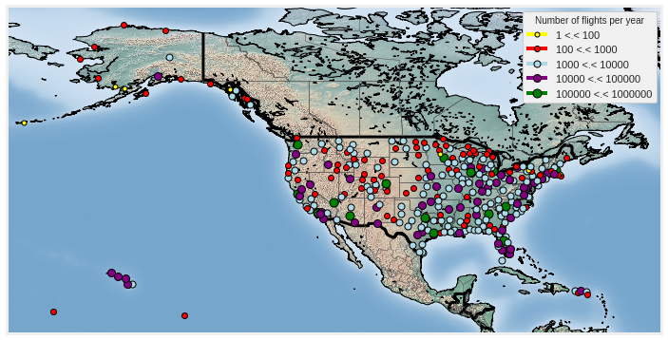
2015 U.S. Airport Flight Distribution

Slide 12
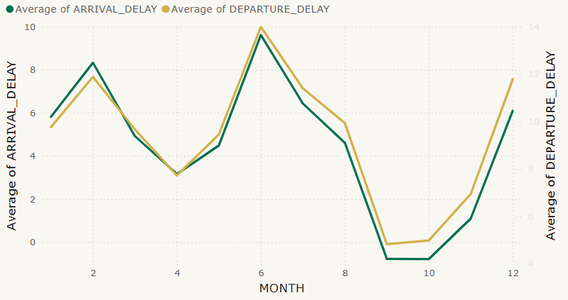
Average of delay per month
This chart shows the average arrival and departure delays across difference months.
Seasonal trends, weather conditions and holidays may contribute to variations in delays

Slide 13
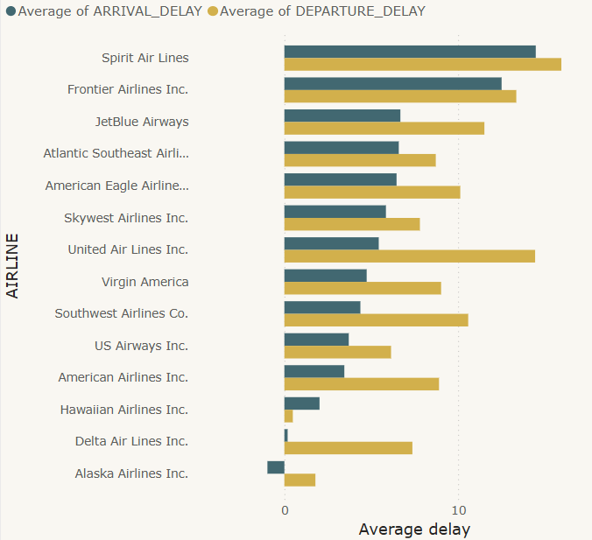
Average of delay by AIRLINE
This visualization compares the average delays for different airlines. Some airlines may have better on-time performance due to fleet efficiency, airport hubs, or operational strategies.

Slide 14
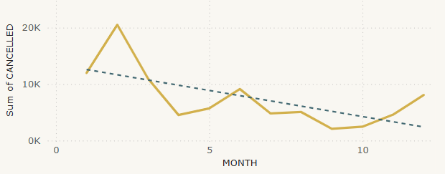
number of cancellation per month
Displays the monthly trend of flight cancellations. Weather conditions, mechanical issues, and airline policies could influence these numbers.

Slide 15
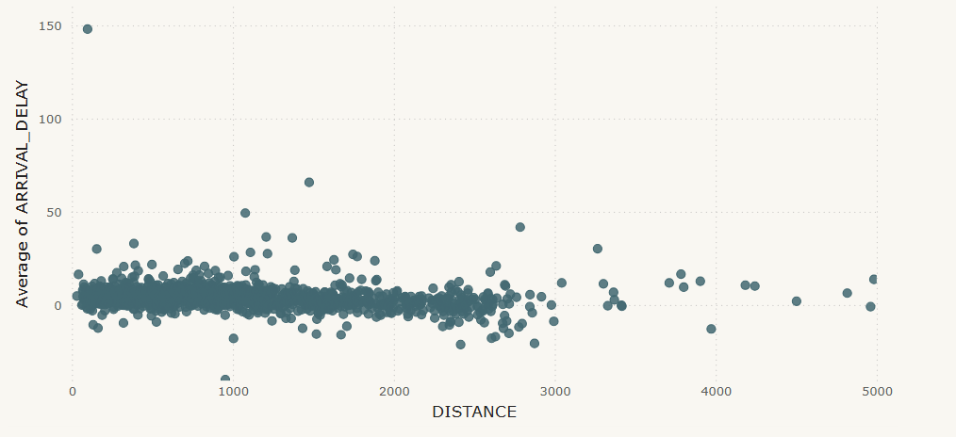
Average of DELAY by DISTANCE
A plot of average arrival delay versus flight distance shows no clear correlation, indicating that delay times are not strongly related to how far a plane travels.

Slide 16
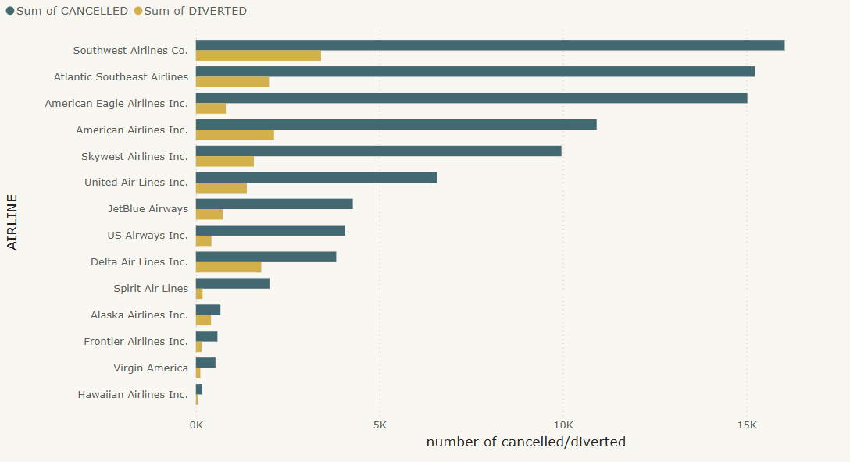
Sum of CANCELLED and DIVERTED by AIRLINE
Compares airlines based on the number of cancelled and diverted flights. Some airlines may handle disruptions better than others

Slide 17
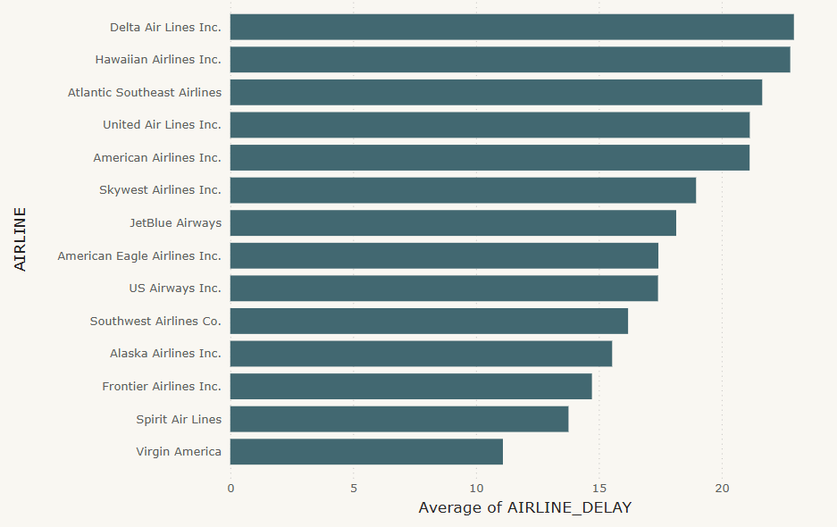
Average of AIRLINE_DELAY by AIRLINE
This chart ranks airlines based on their overall flight delays. Operational efficiency and airport hubs play a role in these rankings.

Slide 18
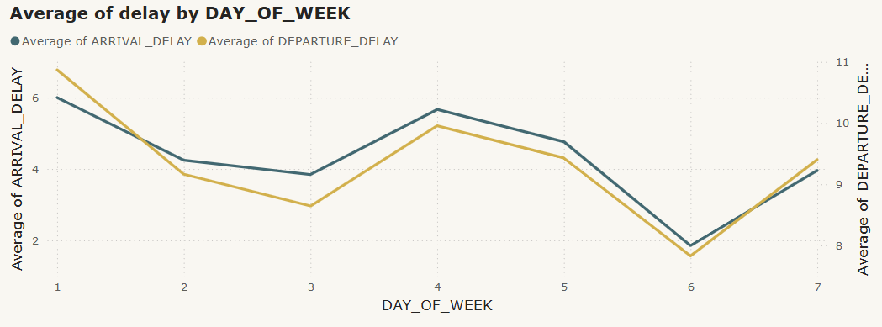
Average of delay by DAY_OF_WEEK
Examines whether certain days have higher delays. Weekends or peak business travel days might see different delay patterns.

Slide 19
04
Learning

Slide 20
Thanks!
Do you have any questions?
amirrfz2003@gmail.com

